Slide 1
GCI Final Project
〜Delivering AI Technology to HomeCredit, Which Has Entered the Japanese Market〜

Slide 2
Introduction
In this business proposal, we assume that HomeCredit has entered Japan since 2018 and is seeking for new business opportunities. Based on that, we set several assumptions to smoothly carry out the business plan.
The absolute values of the monetary amounts used in the slides remain the same as in the original data, but we proceed with the discussion using Japanese yen for all currency units. Therefore, when calculating actual amounts, conversion from Japanese yen to the true currency is necessary; however, ratios between amounts do not change, so we adopted the above assumptions. The quotation is also made under this process, so you can obtain the true values by converting (multiplying) as needed.
When predicting interest, we needed features representing interest rate and repayment period, but these were not in application_train, so we used previous_application to predict features representing the repayment period and used those to compute interest.
Main References：
“Current State of the Money Lending Industry and the Actual Conditions of Funding for Businesses” (Japan Moneylenders Association) https://www8.cao.go.jp/kisei-kaikaku/suishin/meeting/wg/toushi/20190411/190411toushi05.pdf
「Home-credit-annual-report-2017」（HomeCredit）https://www.homecredit.net/~/media/Files/H/Home-Credit- Group/documents/reports/2018/home-credit-annual-report-2017.pdf
「Home Credit Default Risk」（Kaggle）https://www.kaggle.com/c/home-credit-default-risk/overview

Slide 3












Overview of the new AI Business
We realize diverse data analysis with AI from large volumes of customer data.
Two core business proposals
Three targets supporting new business
①Default customer prediction
By breaking down into these three points, more stable business profits can be expected.
Among customers who applied for loans, AI automatically identifies those who are likely to fall behind on repayments or become unable to repay.
- Acquisition of new customers
- Retention of existing customers
- Business level improvement through long-term operation
Existing customers
②Default Trend Analysis
New customers
long-term operation
We analyze the tendencies of customers who have previously fallen behind on repayments or become unable to repay, and support management strategies and sales advertising based on the insights.
Business profit

Slide 4
Proposal for New AI Business ①
Default Customer Prediction – Never Miss a Repayment Delay –
AI enables diversified data analysis from a large volume of customer data.
Current Status
After Implementation
Newly applied customers may become delinquent on their repayments or may be unable to repay.
Among the new applicants, AI automatically extracts those who are highly likely to become delinquent or unable to repay.
New
As the amount of accumulated historical data increases, the probability of extracting valuable information rises, leading to improvement in default judgement..
Customers who did not delay their repayments previously may become delinquent with the new plan.
Existing
Long- term
We swiftly propose multiple countermeasures that cover the worst-case scenario, and can help you with loss-cutting.
Sudden recession may make customer acquisition and retention difficult with the current sales methods

Slide 5
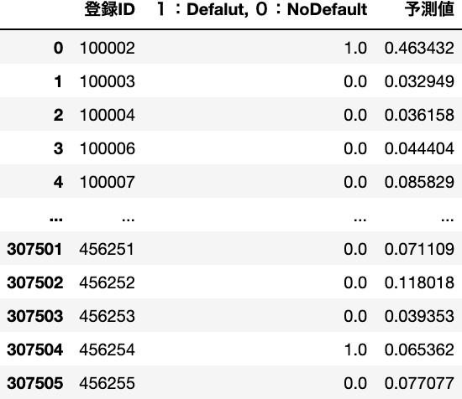
Use Case 1: Revenue Maximization System by Default Customer Prediction (PMS)
System Overview
Q&A Before Detailed Explanation
Maximize net profit through Default customer prediction using machine learning. Hereafter, the system will be referred to as PMS (Profit Maximization System).
Q: How do you measure the quality of a system?
Purpose
A, The quality of the system is evaluated using an evaluation metric.
Just like batting average in baseball or viewer ratings for TV, evaluation metrics can measure the prediction accuracy of machine learning.
Overview
Offer the requested loan amount to customers predicted to be capable of repayment.
For customers predicted to have difficulty repaying, adjust to an optimal amount before lending or decline the loan.
The evaluation metric (AUC) used in this analysis has the following characteristics.
It is often used for binary classification (determining Yes or No).
It takes values in the range of 0 to 1, and the closer to 1, the better the prediction.
Values between 0.7 and 0.8 are considered to have moderate effect, and those above 0.8 are said to be very effective.
Based on these two principles, we minimize your opportunity losses and maximize net profits.
We achieve the minimization of your opportunity loss and maximization of net profits.
Q: What is the actual accuracy?
This prediction uses only the basic data.
ID
Prediction
Usefulness
In addition to maximizing profitability, offering customers an optimal loan amount based on prediction before borrowing helps them use loans with greater confidence. Customers today seek lenders that are approachable and trustworthy — making such efforts vital to addressing their needs
AUC＝0.765
We were able to achieve this level of accuracy.
Since this corresponds to an AUC of 0.7 to 0.8, it indicates that a moderate effect can be expected.

Slide 6
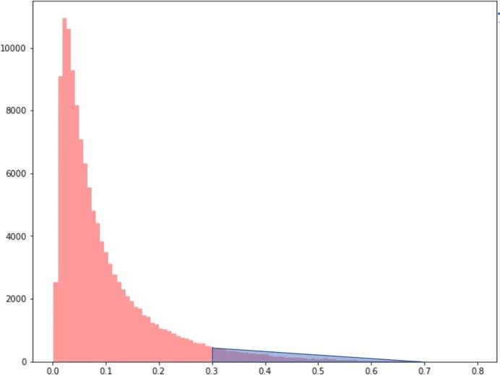
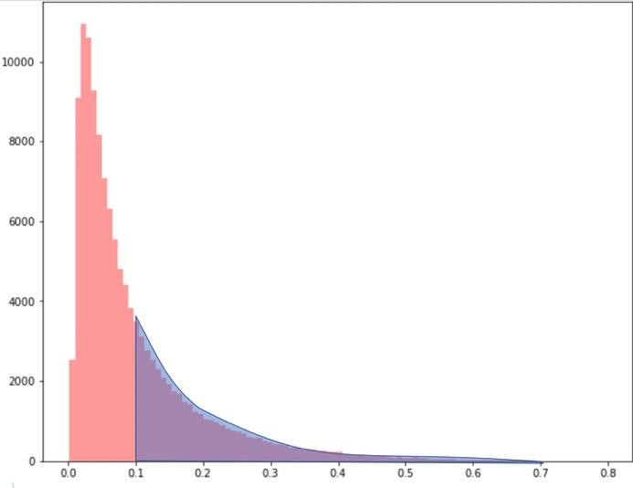
Example of application 1: Revenue Maximization System (PMS) through Default Customer Prediction
Classification method based on Default prediction
Table 1
ID
Prediction
Q How are the obtained predicted values used to identify default customers?
In this system, the predicted value is output as the probability of default.
Table 1 on the right shows
the IDs of customers who used cash loans
Whether a default actually occurred (1: Default, 0: No Default).
the prediction (the likelihood that the customer will default).
fig１
Blue: Default
Red: No Default
In practice, determining at what probability to be judged as default, in other words, setting the default threshold, is key to increasing profits.
If a predicted value of 0.3 or higher is considered a default
If a predicted value of 0.1 or higher is considered a default
In Figure 1 on the right, the customer distribution is shown as an example when the default threshold is set to 0.3 or 0.1. It visualizes how changes occur when the default threshold is varied.
In PMS, by moving such cutoff values within the prediction range, it is possible to automatically detect the cutoff value that maximizes revenue.
Predicted value
Predicted value

Slide 7
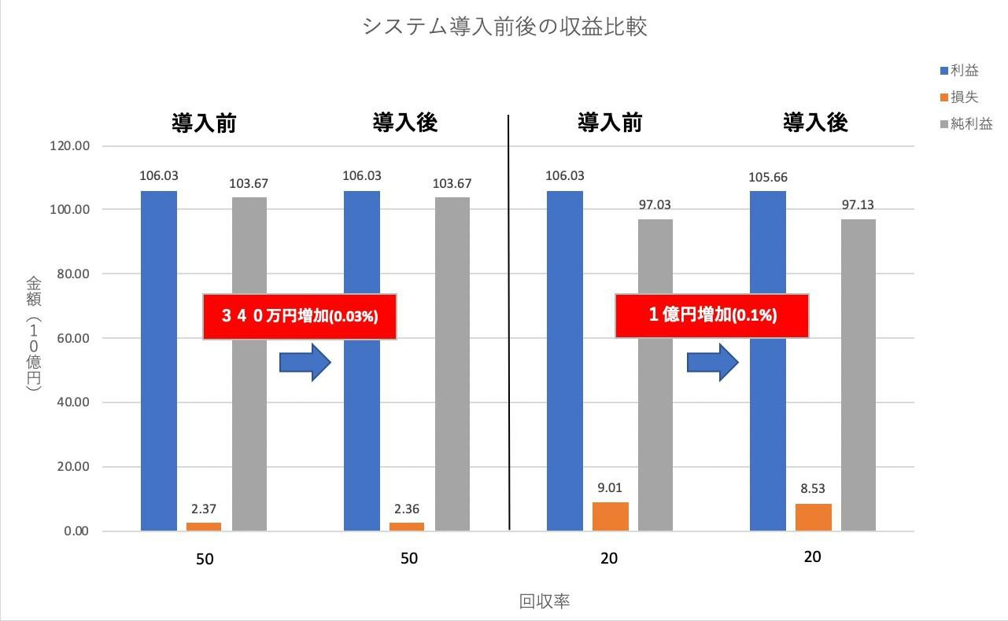
Revenue Prediction by PMS (Simulation)
Assumptions
Data: Profit and loss of customers with Cash loans are defined as follows.
Profit = Σ (Interest)
The total interest collected from customers who can fully repay (No Default)
Loss = Σ{Loan Amount - Recovery Rate × (Loan Amount + Interest)}
Total amount of unrecovered money from customers who delay repayment or become unable to repay (Default).
Since the system development competition is held on Kaggle,
the recovery rate for default customers is low, set at 50% or less.
Explanation of the predictive model
We predict whether customers will default based on accumulated data.
We use machine learning methods (Decision Trees / LightGBM).
Decision trees split data step-by-step, making the analysis results easy to understand, and they are characterized by their ability to achieve high-accuracy predictions regardless of the data format.
The default threshold is automatically determined to maximize revenue under normal situations, so what you only need is data!
Illustration of a Decision Tree
Revenue Prediction (Simulation)
※ As mentioned in Assumptions, this prediction is preliminary. After this business proposal is adopted, the prediction is to be applied not only to cash loans but also to all loan types and to all customers.
Proportion of loan types
Comparison of Revenue Before and After System Implementation
profit
Before
After
Before
After
Loss
Net profit
Amount (1 billion yen)
An increase of 3.4 million yen (0.03%)
An increase of 100 million yen (0.1%)
Recovery rate
As can be seen from the above graphs, the increase in revenue after the introduction of the PMS is only about 0.03 to 0.1% of the overall net profit.
Still, we propose our PMS because it not only boosts profitability but also has extremely high applicability.
In the next slide, we will introduce its applications in various cases.

Slide 8

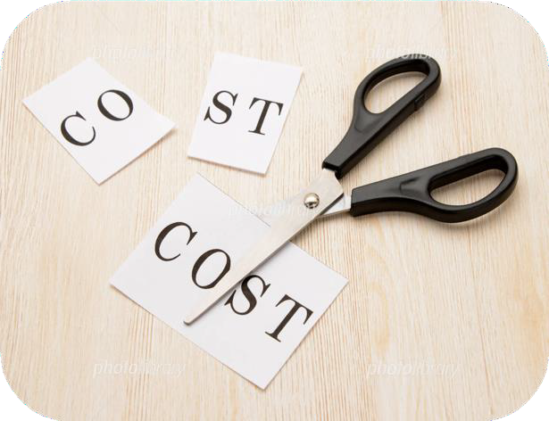

Application cases of PMS
In introducing new technologies, applicability is an important factor.
Ready for unseen future data
Applicable even during high default periods
Increase customer satisfaction
The greatest advantage of the profit maximization
The greatest value of PMS is that it enables to propose the maximum refundable amount to each individual customer!
Prioritizing customer satisfaction may temporarily reduce apparent profits. However, as customers can borrow money worry-free, the repeat rate is expected to increase. This can leads to higher corporate reputation and, ultimately, long-term growth and stability in net profit.
Reduce labor costs
Anyone can become a talented person who can play an active role.
Until now, the screening related to lending has been left to experts with excellent statistics and long practical experience. However, consultation fee is quite expensive!
PMS enables automatic screening just by data. No expertise required! The expense cut by PMS can be returned to current employees as salary or welfare benefits.
Since the model adopts multiple models such as highly interpretable models and rule-based algorithms, it can be flexibly modified, preventing worst-case scenarios in advance!
By switching automatic default assessment to manual, you can shift the goal from profit maximization to loss minimization.

Slide 9
Proposal for New AI Business②
Default Tendency Analysis〜Supporting Business Strategy〜
AI enables diversified data analysis from a large volume of customer data.
Current situation
Solutions
Want more people to know and use HomeCredit! And to increase the number of new applicants!
Want suited plans for those customers who use the service for a long time or multiple times!
Want to adapt to market trends and changes in segments and aim to expand our industry share from a long-term perspective!
By focusing PR efforts on groups with a low predicted default tendency, you can optimize of sales and advertising.
New
Re-propose the optimal plan tailored to each individual customer based on past data.
Existing
Long- term
By detecting changes in default trends with high sensitivity, we can respond to customer needs more swiftly than competitors, possibly expanding our market share.

Slide 10
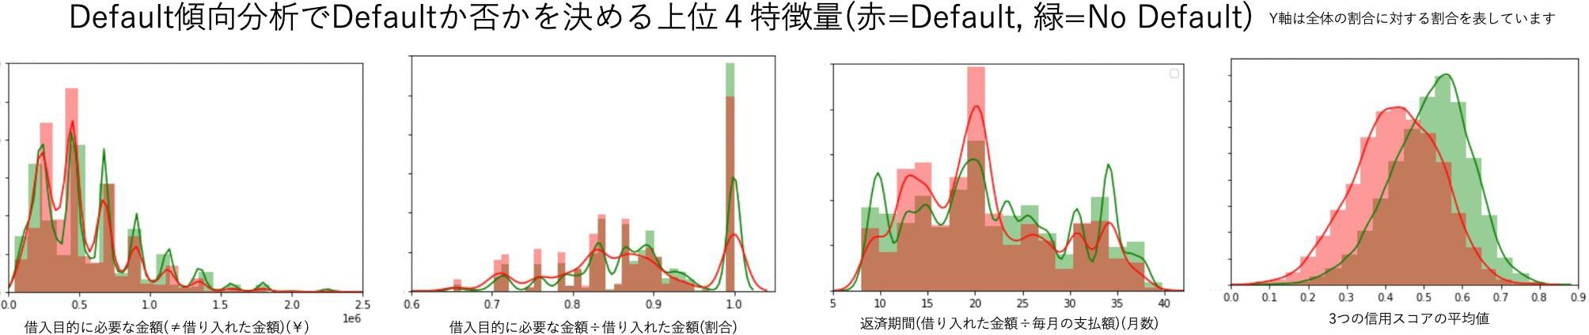
Use Case 2: Issues Visualized through Default Trend Analysis
We have entered an era where human judgment alone is insufficient!
The graph below visualizes the top four features that determine whether a customer defaults or not, based on default customer prediction.
There are two major insights that can be drawn from these.
While the credit score is a fairly straightforward feature, it is necessary to correctly distinguish people who fall within the overlapping area (blue region) on the graph.
For all the other three features, there are areas with many red points in the middle section overall (black line area). These areas suggest that man-made judgement could not predict appropriately, and that plans that were not suited for the customers had been proposed.It is extremely difficult to investigate features prone to default manually. Understandable features such as the credit score can be biased.
These issues can be clarified not only by predicting defaults but also by conducting default trend analysis.
The insights gained can be utilized in many areas such as sales, advertising, and planning, providing new perspectives for management strategy.
Top 4 Features Determining Default or Non-Default in Default Trend Analysis (red=Default, green=No Default)
Required Loan Amount for the Borrowing Purpose
Required Loan Amount ÷ Borrowed Amount
Repayment Period (Borrowed Amount ÷ Monthly Payment)
Average of the Three Credit Scores

Slide 11



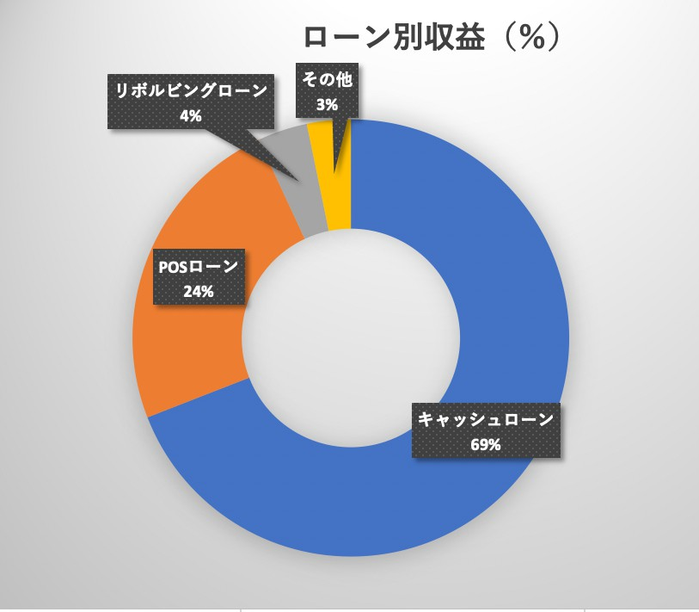
Use Case 3: Expansion of New Financial Services
Using default analysis, these service can also be realized!
Current state and issues of the industry
Category | Findings from the Survey
Changes in the Macro Environment ・Widening economic disparities ・Advancement of the information society | ・In response to changes in the social environment, it has become an urgent task to enhance credit assessment capabilities through the use of fintech and to improve user convenience by expanding new financial services.
Status of Borrowing Behavior ・Purpose of borrowing ・Motivation behind borrowing | ・Even as the business environment continues to change, there remains a steady demand for short-term borrowing such as temporary working capital. ・Various funding needs exist depending on the business conditions and circumstances of borrowers. ・Lenders play an important role in supporting the continuity of borrowers’ business activities, and are expected to provide consultation and assistance that respond flexibly to sudden changes in their situations.
Safety Net | ・Counseling services provided by lenders regarding repayment are highly beneficial. ・Efforts to improve public awareness of available consultation services and support desks remain a key challenge. ・There is growing concern about an increase in cases where borrowers who are unable to obtain legitimate loans resort to borrowing from illegal lenders.
Expectations Toward Lenders ・Reasons for choosing a lender ・Requests toward lenders | ・Borrowers place a high value on the convenience offered by lenders. ・As the social environment surrounding borrowers continues to change significantly, the value of lenders as familiar financial institutions has been increasing more than ever before.
AI Purchase Analysis
Customer Information
Limited Plan Proposal
Limited Plan Proposal
Loan Repayment
Merchant
Customer
Your company's revenue by loan type (2017)
Revenue by Loan Type
Cashback
Revolving Loan
others
Overview
Currently, although the purposes for borrowing are becoming diverse, 70% of them are cash loans, which are usually used especially for purchasing home appliances, traveling, home renovations, education, wedding expenses, medical expenses, and various other purposes.
The new service utilizing default analysis offers benefits to your company, merchants, and customers. The benefit to customers is that by contracting with a HomeCredit loan, they can repay cheaply and with peace of mind. Also, merchants do not need new capital investment to appeal only to targeted customers through purchase analysis. Furthermore, your company can expect a significant increase in revenue by increasing the number of users.
POS Loan
Cash Loan
Above table: Excerpted from "Current Status of the Loan Industry and the Actual Situation of Fund Procurement by Operators" Below graph: Excerpted from "home-credit-annual-report-2017"

Slide 12
Quotation
Sale of Default Customer Prediction and Default Trend Analysis
Consulting Contract
Content
Automatically identify customers with a high likelihood of default based on the provided customer data.
Using these predictions, the system automatically determines the optimal default threshold to maximize profitability and support management decisions (PMS).
By analyzing the trends of defaulting customers, the system enables early detection and prompt resolution of potential issues.
Content
Training and education for in-house system personnel
Development of new models on a case-by-case basis
Comprehensive management consulting
Proposals for joint new business ventures
内容
Content
Price
We are offering the complete AI-based system, including PMS, for a total price of
150 million yen
Price
The monthly contract is set at 1 million yen, and the annual contract at 10 million yen.
For the PMS system targeting cash loans alone, an annual profit increase of approximately 30 to 100 million yen is expected. Taking into account its various potential applications and strong future prospects, we have set the price at this level.
Also, for three years after signing, we will provide the consulting contract shown on the right free of charge. Renewal will be required from the next fiscal year.
Regarding the new business proposals introduced above, in principle, all joint business projects can be undertaken based on the pricing indicated here as the standard fee.
(Additional performance-based compensation may be applied depending on the circumstances.)

